Slide 1
Dream Team
Electric Vehicle Project
Sponsors: Ted Eastman - UCSC IDEASS program
Ben Werner & Eric Sandoz - Revolution Motors

Slide 2
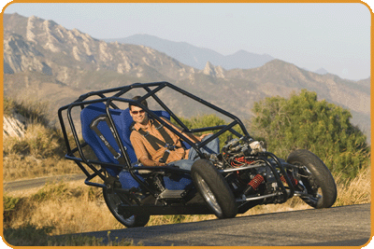
Problem Statement
The Dagne EV - a three wheeled electric vehicle with lean action, prototyped by Revolution Motors and donated to the university educational purposes.

Slide 3
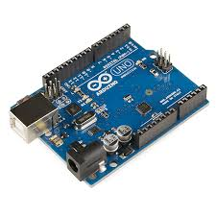
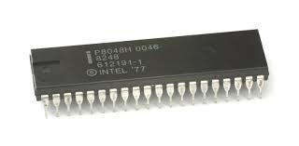
Problem Statement
Ted Eastman - UCSC IDEASS program mentor* - wants an Arduino version of the microcontroller on the Dagne for the purpose of an “open-source” vehicle.
Task-at-hand: Convert Intel 8051 to Arduino.

Slide 4
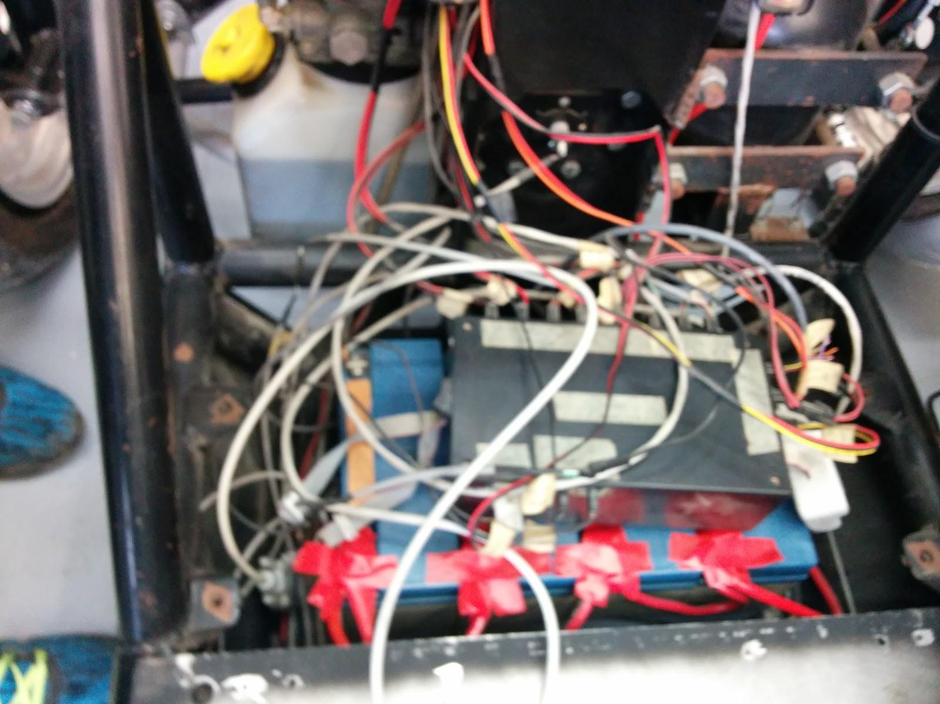
Biggest Challenges and Accomplishments
Delay getting the original source code
Lack of original documentation
Created documentation
Covers design of original source
Covers implementation on the Arduino
Can be used by future development teams on the project
Began implementation for the Arduino

Slide 5
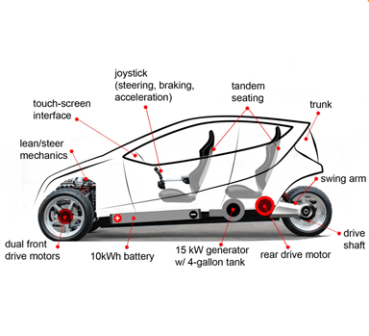
Goals we set out to achieve &
Goals we did achieve
Original goal: To translate the old micro controller code into Arduino C code.
^{Achievements:}
^{Documentation of old code}
Individual modules working on a simulator
We are about to install it on the Dagne

Slide 6




Technologies Used
Hangouts
123D Circuits
GitHub

Slide 7
Project management techniques
Whiteboard for Scrum board
Hangouts for organizing the Scrum meetings
Discussions

Slide 8
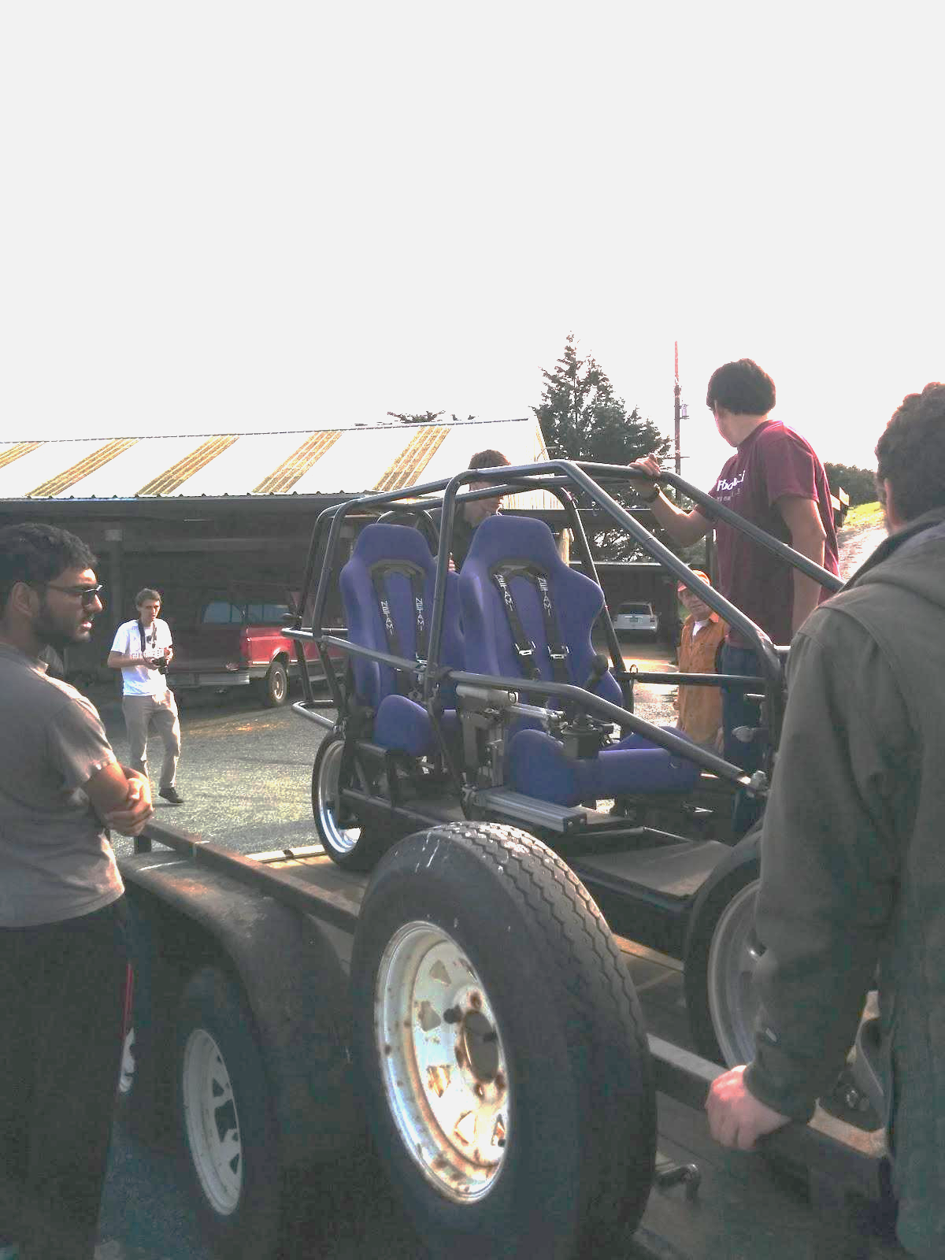
Things we enjoyed/didn’t enjoy
What we enjoyed:
Working with Arduino
Coding in Arduino C
Getting to work with the Dagne vehicle and examine its components
Getting to work with each other
Team meetings were very productive.
What we did not enjoy:
The source code came very late.
We could not properly test using the Dagne
There was a slight accident with an Arduino board at one point.

Slide 9
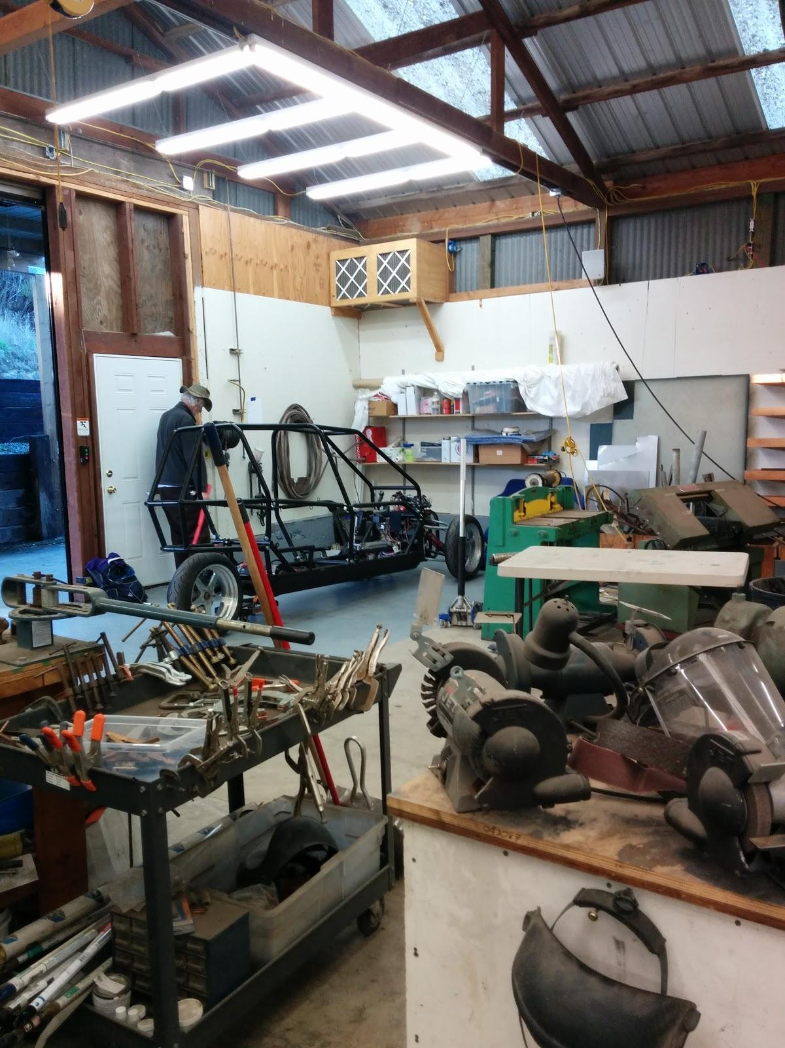
Lessons learned
Scrum meetings:
Should be spaced out evenly
Best in conjunction with longer logistical meetings
Scrum board:
Requires clearly-defined tasks from outset
Needs to be updated every meeting
Rewriting old code for different hardware:
Need technical knowledge of both systems
Sometimes better done from scratch

